Slide 1
DWQ Municipal Wastewater
Planning Program (MWPP)
Results

Slide 2
MWPP Survey
Conducted by Qualtrics Survey Software
Increased Facility Management Level Completing Survey
Broken into: Financial, Collections, Lagoon, Nondischarging, and Mechanical
Contains 336 different question fields
Second year data is 100% digitally available
First year data can be queried from a database

Slide 3
MWPP Survey Reponses
Resulted in 100 unique responses from facilities
Reporting Facilities Account for 86% of the flow discharged under UPDES Permits from 28 facilities.
72 remaining facilities are collections or non-discharging
These 100 responses represent a service population of approximately 3.26 million residents of Utah.
These 3.26 million residents are served by approximately 587 collection system operators and 333 treatment system operators.
Discharging facilities which did not file a 2018 MWPP are: Jordan Basin, Brigham City, Price, Moab, Moroni, Stansbury, Hyrum, Wellsville, Plain City, Salem, Coalville, Springdale, and Oakley.

Slide 4
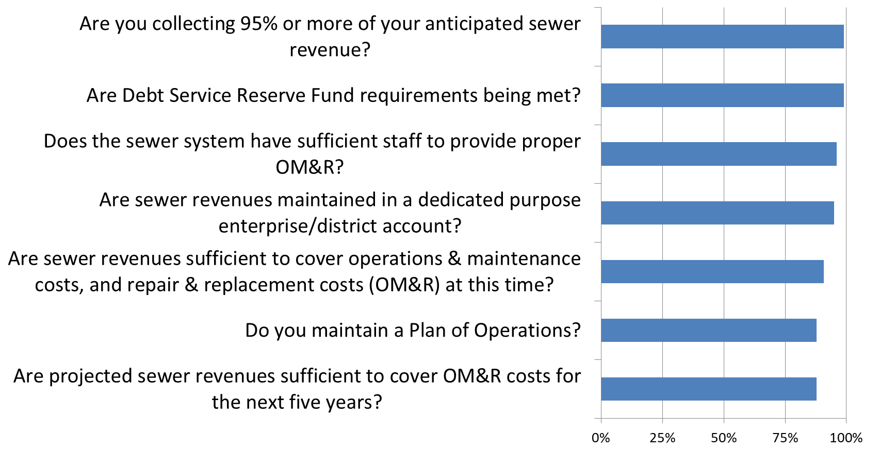
88% Yes and above
Percent Yes

Slide 5
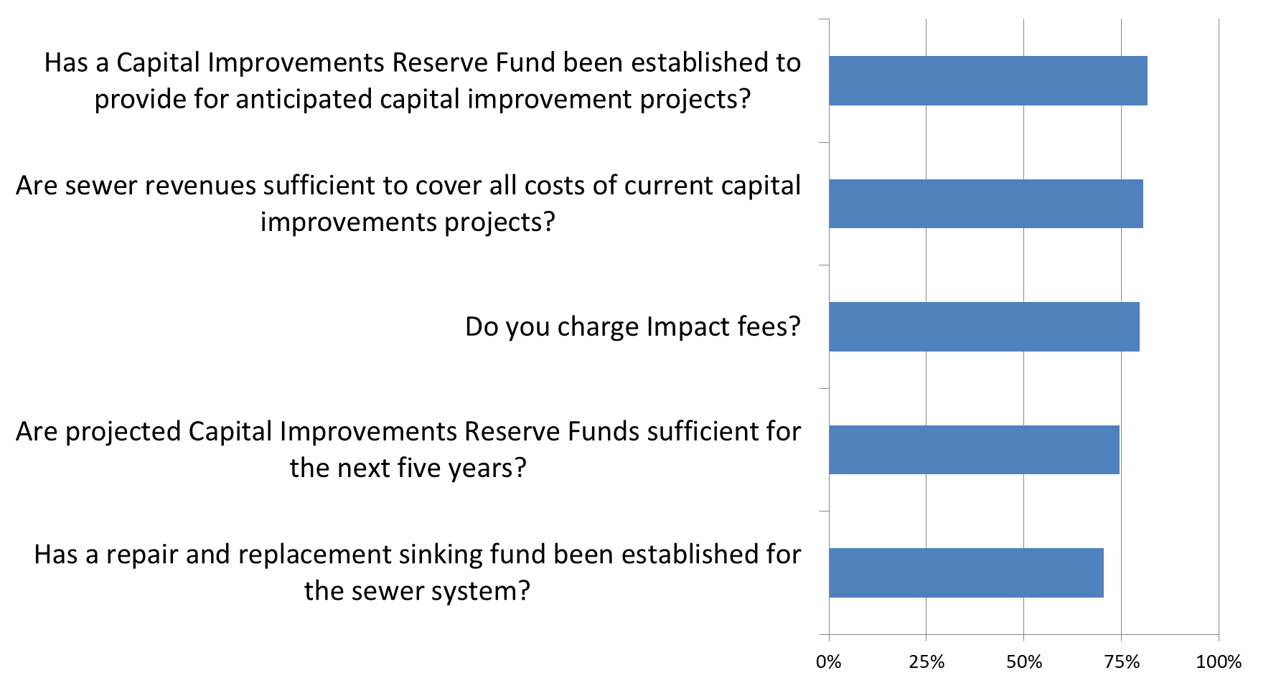
70% to 82% Yes
Percent Yes

Slide 6
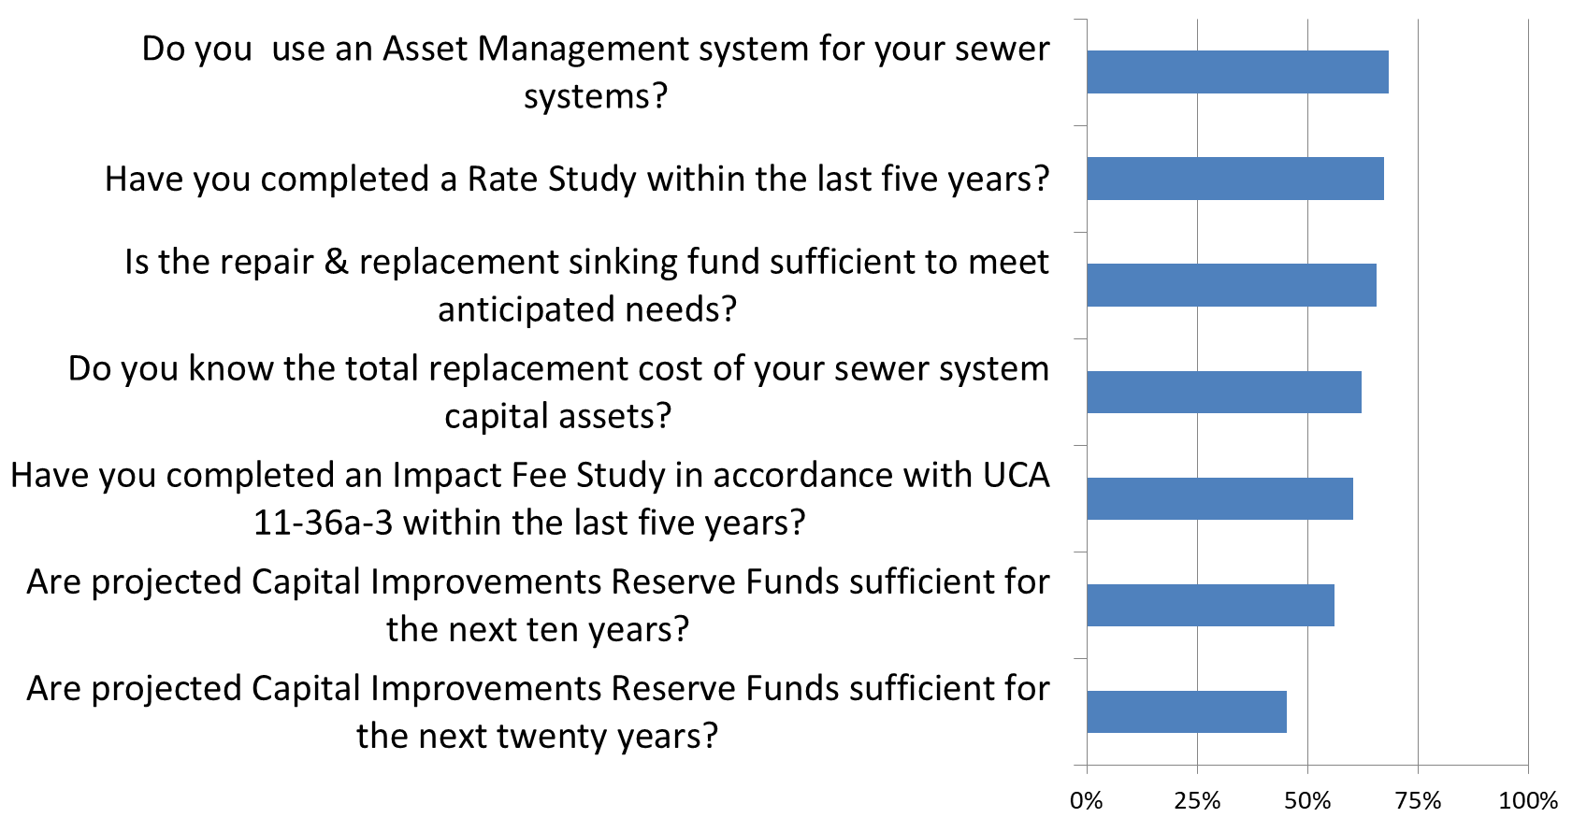
68% and below Yes
Percent Yes

Slide 7
MWPP Survey
86 Facilities Reported Their Estimated Projected Financial Need over next 6 years
30 Facilities with $1,000,000 or less
22 Facilities with $1,000,000 - $3,000,000
11 Facilities with $5,000,000 - $10,000,000
7 Facilities with $10,000,000 - $30,000,000
7 Facilities with $30,000,000 - $62,000,000
8 Facilities with $90,000,000 - $600,000,000

Slide 8
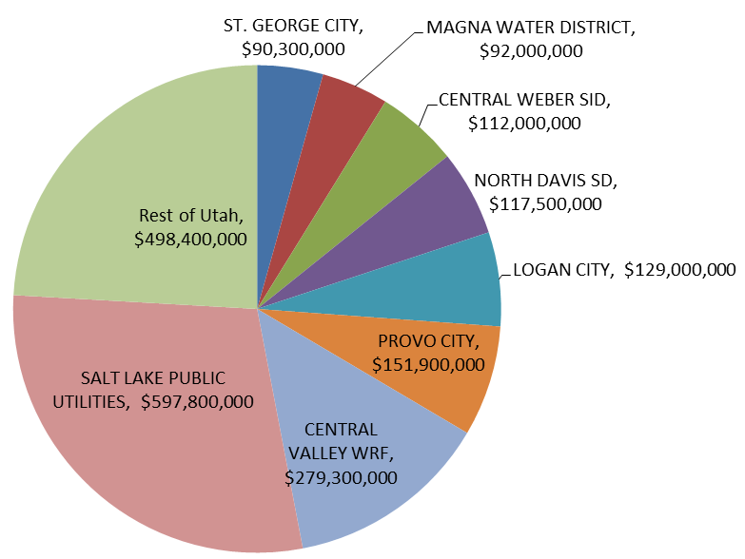
Projected Financial Need Through 2025
Total
$2,129,000

Slide 9
Ken Hoffman, P.E.
(801) 536-4313
kenhoffman@utah.gov

